Slide 1


Slide 2
Lecture 03
Mental Abilities
Verbal Ability
Mechanical ability
Numerical ability
Social Ability
Practice session

Slide 3
Verbal Abilities
Include the followings
Number and letter series
Coding and decoding
Relations identifications
Direction Test
Calendar question
And Such like pertains to IQ

Slide 4
Verbal Ability
Type of number series
Series of addition and subtraction
1,4,9,16,25……..?
38,34,30,26,22……?
35,30,24,17……..?
-32,-25,-16,-5,…….?
Multiple series
2,4,8,16,32…..?
2, 6, 30,210……..?
Division
128,64,32,16……?

Slide 5
Odd, Even and prime number series
Adding Digit
1,5,21,67…..?(adding even number squares to previous number)
1,5,14,39……? (Adding the squares of prime number in the previous)
Series of squares and cubes
36,225,576,……..? (First adding three digit then taking its squares)
4,16,36…….?

Slide 6
Series of Square Root
64,4,49,7,36,6,25,…..?
1,4,9,16,25,36,49,……….?
Mixed series
8,12,9,13,10,14,…….?(4 is added and 3 is subtracted)
4,8,10,20,22,………..?( first is multiplied by 2 and 2 added )
6,24,36,60,120,………… (1*2*3), (2*3*4),(3*4*5)
5,11,19,29,………….?
99,95,85,70,…….?

Slide 7
Type 2
2 4 9
3 4 6 7 10 12
5 8 12
2 2 2
3 3 4 6 3 4
4 1 2
8 4 7
2 9 5 4 6 1
10 3 5
14
25
?
72
48
?
18
20
?

Slide 8
Letter Series
J ,z, I ,y, h …………(x,g)
A , E, I, M………..( difference of three letters)
A, E, I, M,……..?
A.z, E.v, I.q,……..?
Find the odd one…..?
EV b) AF c) IZ d) WX
XWV : UTS:: LKJ:?
IHG b) JKL
c) STU d) MNO

Slide 9
CODING AND DECODING
If CDEF stands for 2345 then 3254 stands for?
If Code 1294 means Abid then Diya stands can be coaded as
A) 9967 b) 99(21)8
C) 3429 d) 99(25)1
The word RUN is coaded as SVO which of the following should be code letter for you?
a) PTL b) MBZ
c) SLX d) PCD

Slide 10
If RIGHMG is the code word for PLEASE what should be the code for SLEEP
MIGGR b) GHMGG
c) GMIRG d) HIMMR
If the word MARCH is written as HCRAM What does ELBAC stands for?
a) Tables b) CABLES
c) PANES d) LANES
If vowels are taken out which letter would be the 10th
Consonants from the beginning?
N b) M
c) Q d) R

Slide 11
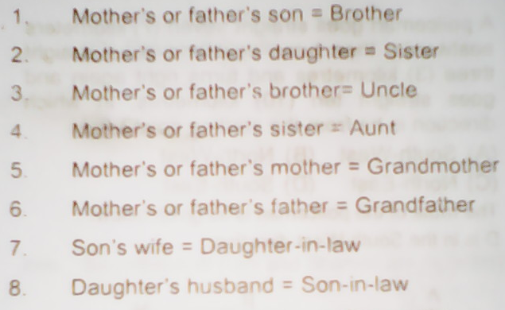
Blood Relation Test

Slide 12
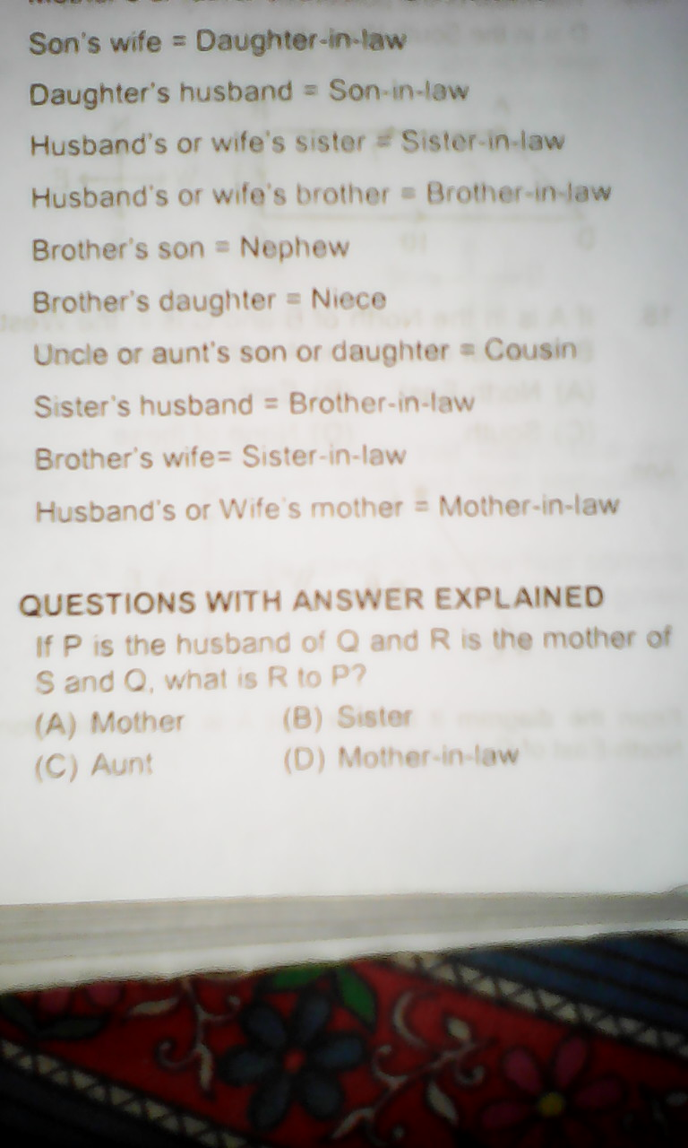

Slide 13
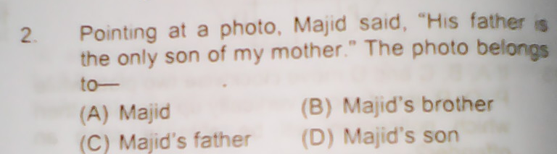
Practice Question

Slide 14
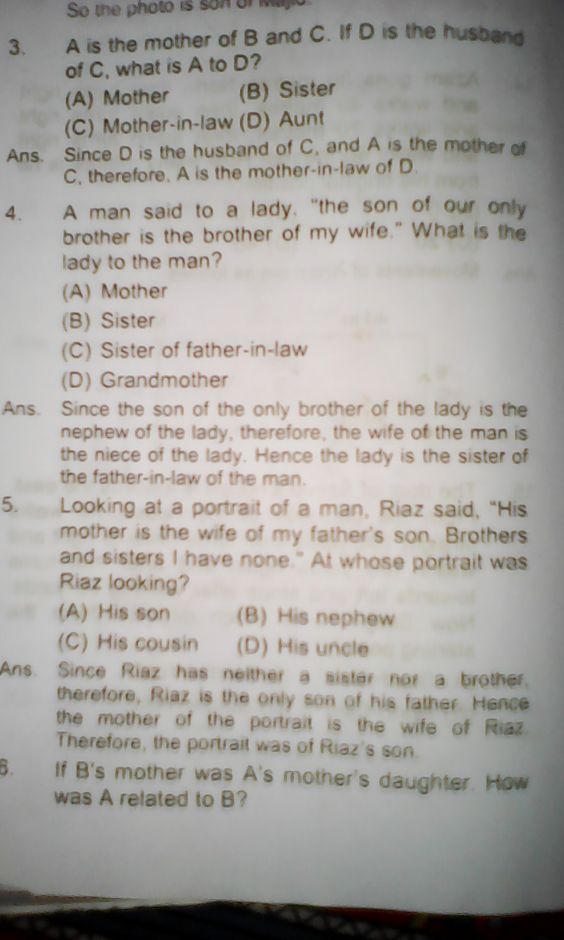

Slide 15
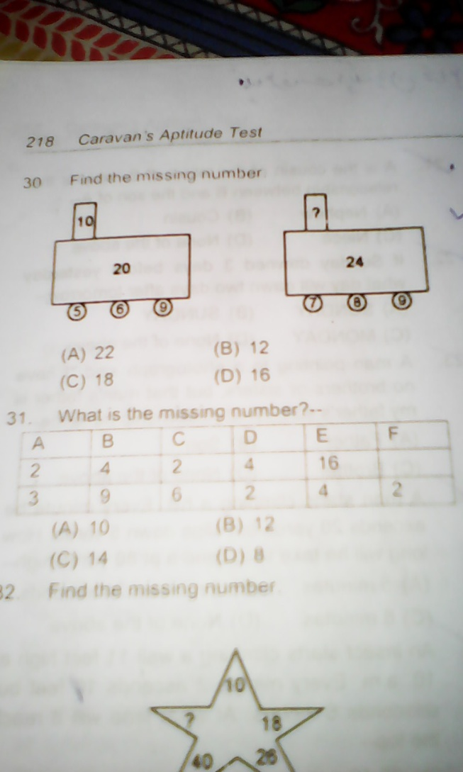
Figurative Test

Slide 16
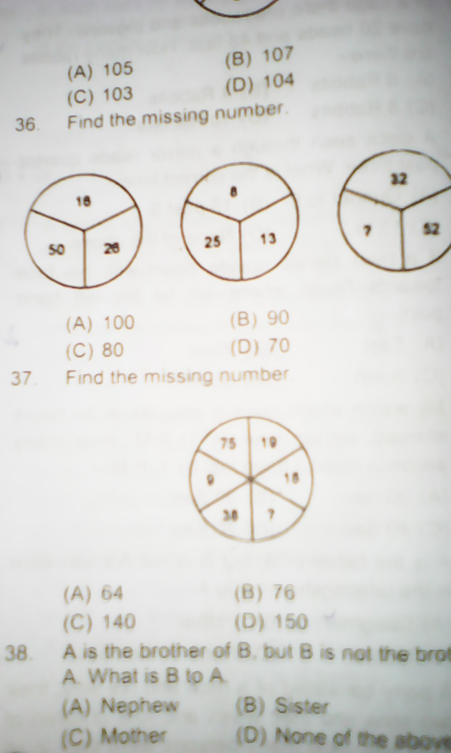
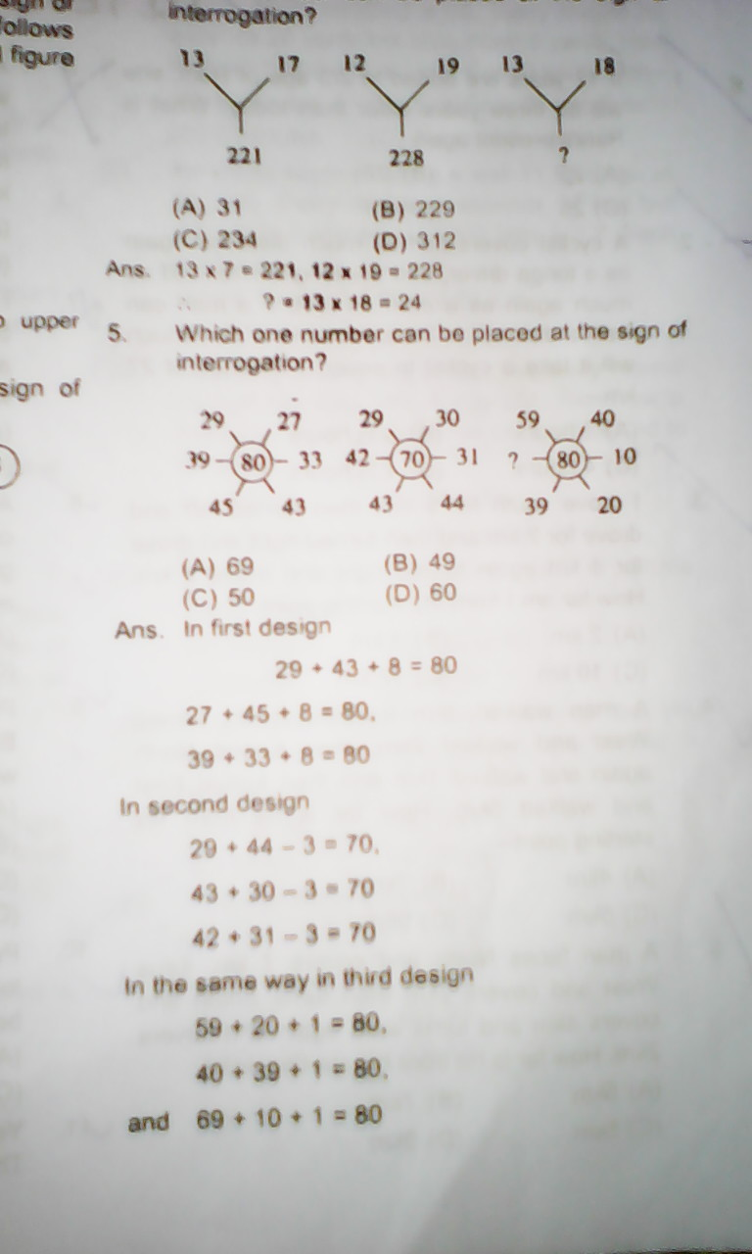

Slide 17
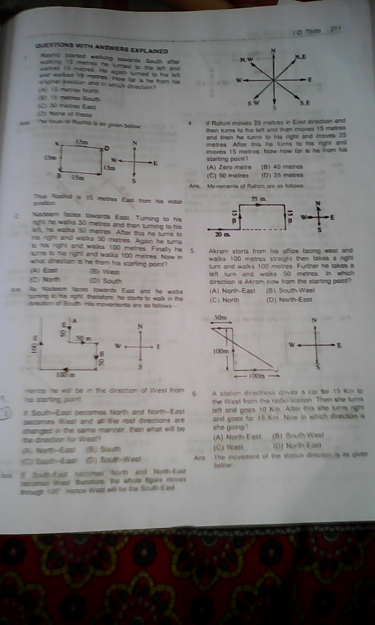
Direction Test

Slide 18
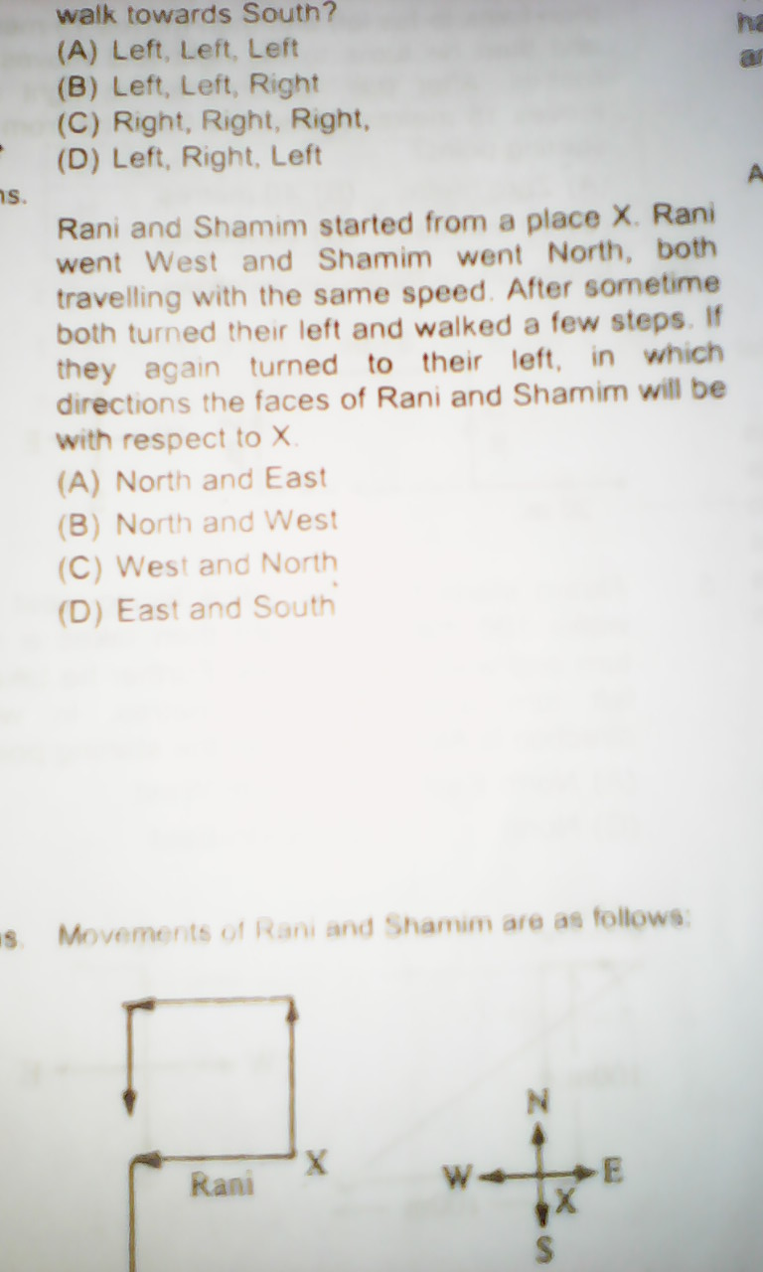

Slide 19
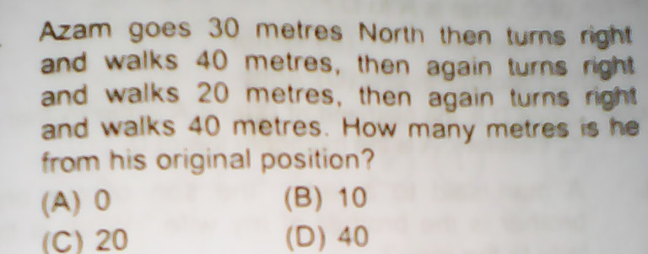
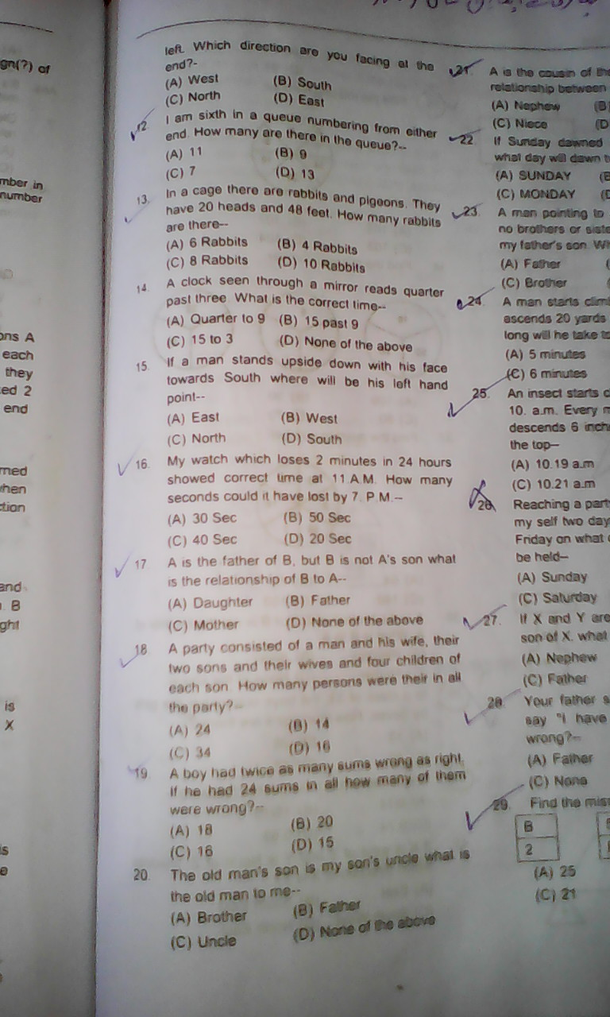

Slide 20
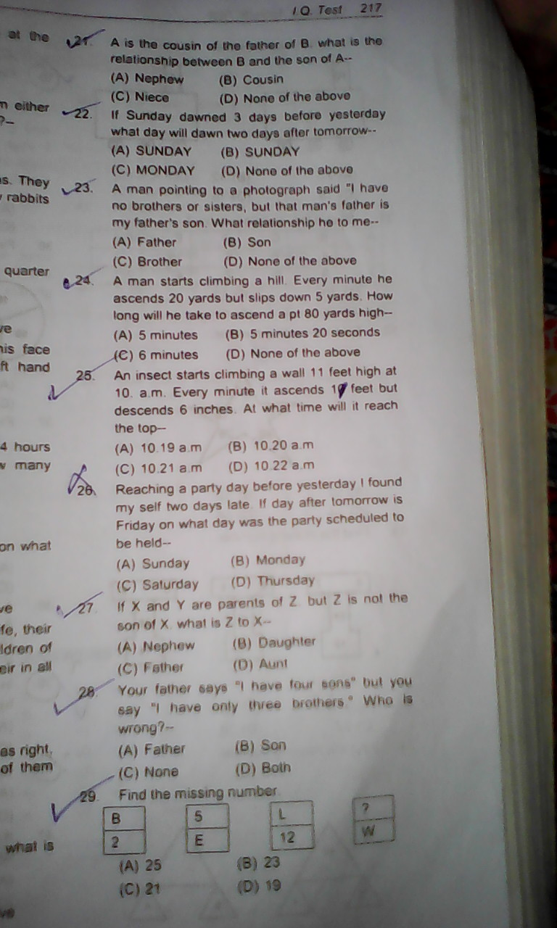
Clock/Time Test

Slide 22
Numerical Abilities
Numerical abilities basically deals with interpretation of numbers in intelligent way quickly.
It may involve basic operations on numbers
To solve fraction, to know which fraction is larger or smeller?
To determine percentage of the given number?
To solve fraction by LCM
To learn How to deal with compound and simple fraction and other such likes

Slide 23
Type 1 (Puzzle)
7 3 8
3 4 2 (The sum of each vertical row is 14)
4 7 ?
13 6 11
4 14 8
15 7 ?
6 4 9
2 1 5
3 2 6

Slide 24
(4 *4/5 )* x = 8
5/3 b) 8/5
c) 4/5 d) 5/4
4/5, 8/14, 9/11 which one is greater?
a b c d
? * 12 = 75% of 96
a) 5 b) 12
c) 9 d) 6
If a>b and b>c, then;
a=c b) a>c
c) c>a d)a<c

Slide 25
7*21/3+3
8/4*2
Is equal to?
13 b) 17
31 d) 1
5/3 + 7/6 + 9/3+7/2 ?
28/3 b) 112/3
28/12 d) 14/7
Which of the following fraction has the smallest value?
a) 1/7 b) 1/8 c) 2/9 d) 5/11

Slide 26
Social Abilities
Test how well you can read emotions of others just by looking at their eyes.
The ability to read the emotions of others is linked to "social intelligence" which, in turn, is linked to performance on team-based problem solving tasks.

Slide 27
Objective of social Ability Test
To check social acceptability of the candidates
To check candidate response how they respond In particular settings
To check candidate social aptitude
For example
You are at some kind of event. There is a group of people to your right, chatting and laughing. You are sitting all alone, watching them. How easy is it for you to get up and join them?
Absolutely no problem.
Its okay. I can do it.
Well... I probably won't do it... but I'll think about it.
Are you kidding? I just hope they don't look at me..

Slide 28
Do you frequently need "Alone Time"?
Yup
Sometimes
Not often
Rare
Would you say that you would rather have people around instead of being alone, and also want to fit in to others groups?
Yes for both!
No for both
I do need people around, but fitting in with others isn't a big concern.
It is essential for me to fit in with others, and I prefer being by myself.

Slide 29
Mechanical Abilities
Mechanical Abilities means that use of devices to bring ease in every day routine works
It may include The use of Pulley's system and Gears or engine shafts
What we have to look in certain settings
Which arrangement of devices can make task easier and harder?

Slide 30
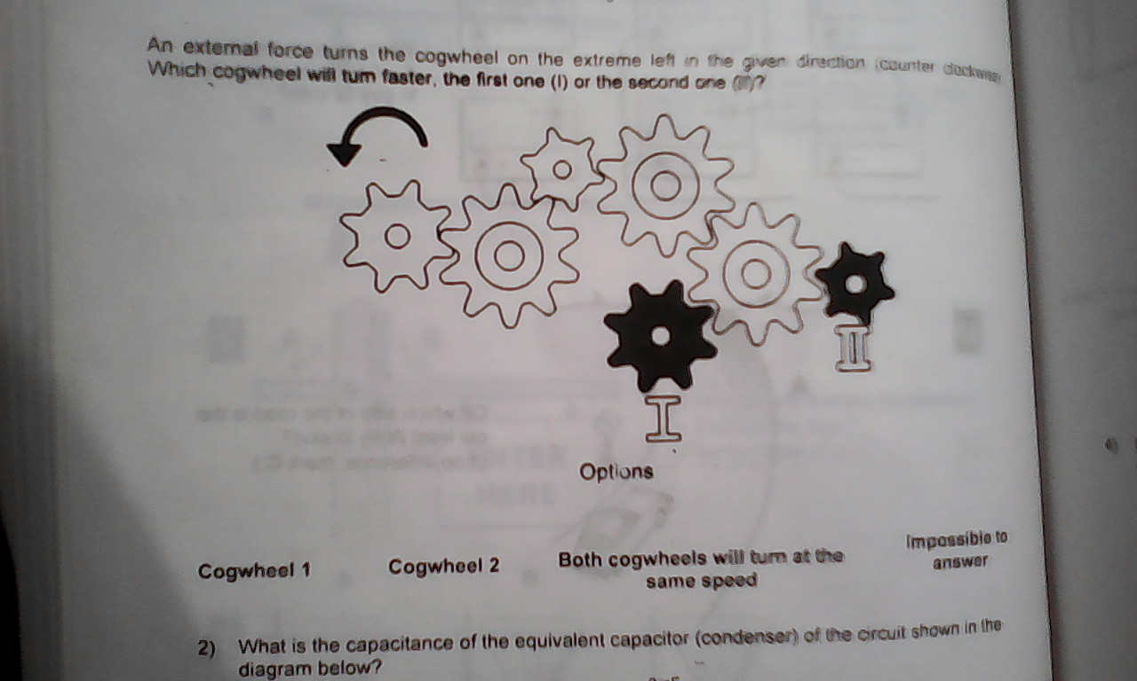
Practice Question

Slide 31
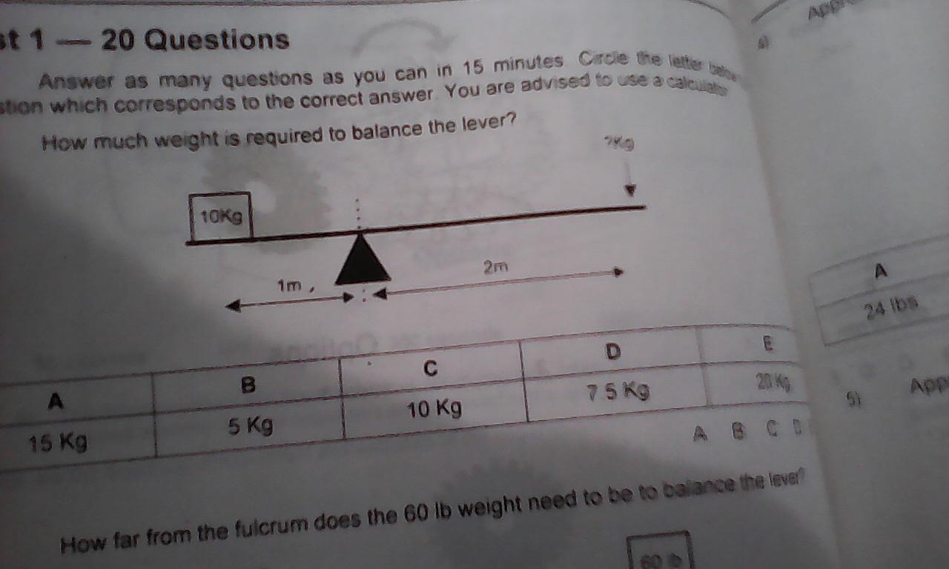

Slide 32
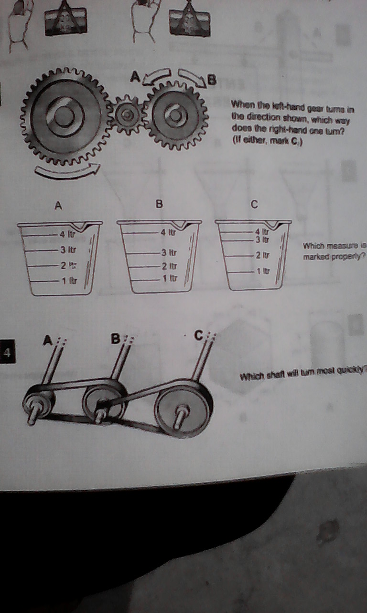

Slide 33
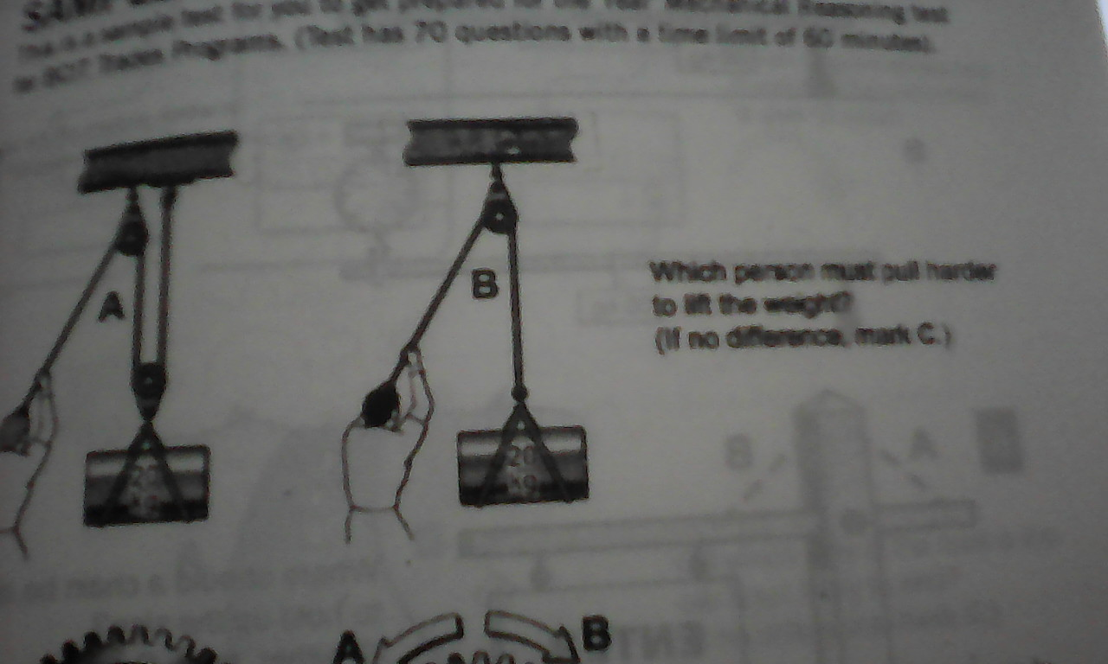

Slide 34
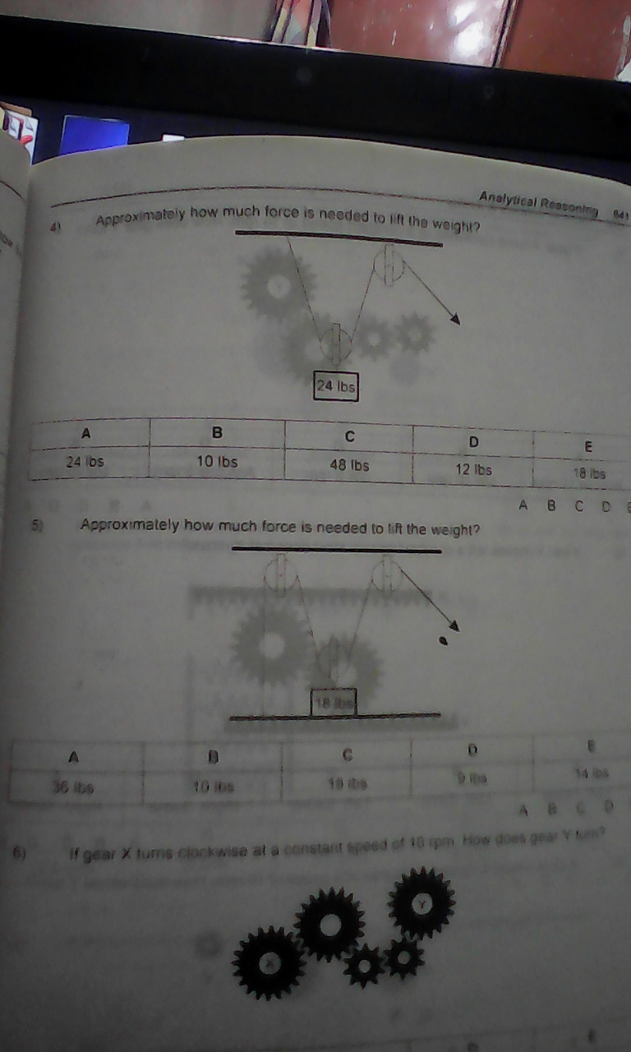

Slide 35
Thank You

